Slide 1
02. Review Divide and Conquer
Design and Analysis of Algorithm (DAA) 2
2016/2017
Abdul Munif

Slide 2
Agenda
Example Case: Cut Rod/Rod Cutting
Overlapping sub problems
Recurrence
Pseudocode → implementation

Slide 3
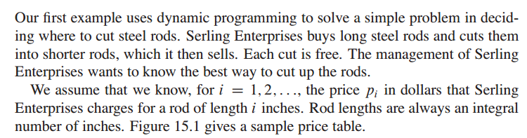
Problem Definition

Slide 4
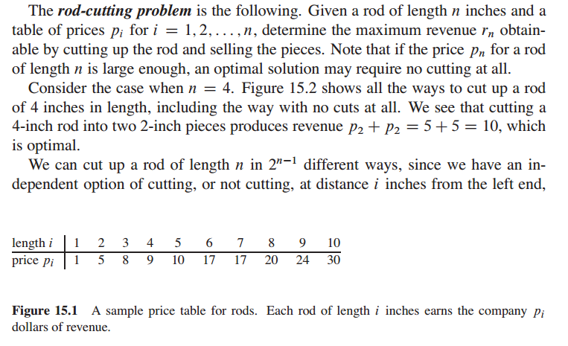
Problem Definition

Slide 5
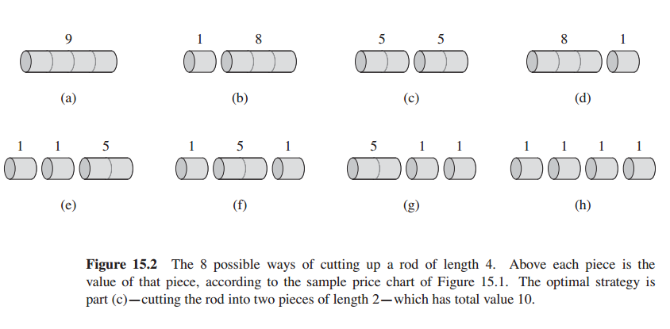
Problem Definition

Slide 6
What is the overlapping sub problem from this example? –Observation-

Slide 7
Deciding the correct recurrence -Abstraction-

Slide 8
Simplify into pseudocode

Slide 9
Recursive Solution

Slide 10
DP Top Down

Slide 11
DP Bottom Up

Slide 12
Terminology
overlapping sub problem
recurrence
memo table
DP bottom up
DP top down

